Slide 1
Chapter 4
Stacks and Queues

Slide 2
Stacks and Queues
Stacks and queues are data structures that have restricted data access, which can be accessed from end or start of the list.

Slide 3
Stack
It is a data structure that has access to its data only at the end or top of the list.
It operates on LIFO (last in first out) basis.
Stack use a single pointer or (index) to keep track of the information or data on the stack.
It has two basic operations
» Push - inserting or adding data at the top of the stack,
» Pop – removing data from the top of the stack.

Slide 4
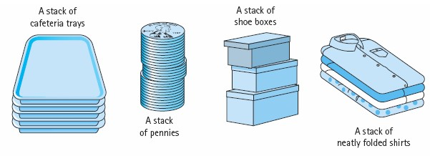
Cont…

Slide 5
Operations
Push
Pop
………………..
……………….
Push(5) Push (6)
Push (9)
Pop Push(7) Push(12) Push(15)
9
6
5
15
12
7
6
5
●
»
12
7
6
5
pop

Slide 6
Array implementation of push and pop operation
Analysis:
» Suppose the stack has the following structure.
int num[Max-Size]; int top =-1;
» We need to have an integer variable that stores an index value that tells us:
– the position where to store a new value
– the total number of elements stored in the stack

Slide 7
To push/add an element to the stack
Check if there is enough space in the stack
» To add new value we should have check the space left
» Top<Max_size-1?
– Yes – increment top , store the element in Num[top]
– No – stack overflow

Slide 8
To pop or remove an element from the stack
Check if there is data in the stack
Top>=0?
» Yes: - copy/remove data at num[top], decrement top
» No: - stack underflow

Slide 9
Implementation – push
int num[max_size];
int top=-1; void push(int x)
{
if (top<max_size-1)
{
top++; Num[top]=x;
}
else
cout<<“stack overflow”;
}

Slide 10
Implementation - pop
int pop()
{
int x; if(top>=0)
{
x=num[top]; top --;
}
else
cout<<“stack underflow”’; return x;
}

Slide 11
Implementation…
Size of Stack
Int sizeofstack()
{
Return(top+1)
}
Is empty
Bool isempty()
{
Return (top==-1)
}
Is Full Bool isFull()
{ Return(top==max_size – 1)
}
11

Slide 12
Linked List Implementation of Push and Pop operations
Definition struct number
{
int num; number *next;
};
Botptr
Topptr

Slide 13
Analysis:
We need two pointers (Botptr and topptr) that points to first and last node of the stack
» number *botptr=NULL, *topptr=NULL;
To push data to the stack
» Check if there is enough space in the stack – i.e free memory space. We need a pointer that points to the newly created -
newnumptr = new number;
newnumptr !=NULL→ there is free memory space pointed by newnumptr
» Yes: - copy/store the pushed value to newly created node
» Create the link between the last node and the new node….

Slide 14
Cont…
» Make topptr to point to the last node (newly created node) →
cin>>newnumptr->num; newnumptr->next=NULL;
» NO: stack overflow
Botptr
newnumptr
Topptr

Slide 15
POP
Check if there is data in the stack
» bottomptr!=NULL???
» Yes: - topptr should point to the previous node. When we have only one node botptr and topptr should point to NULL
» Deleting the last node
» No: - stack underflow
prevptr
lastptr
botptr

Slide 16
Application of Stack
1. Variable declaration
void main()
{
int i, n;
for (i=0;i<=10;i++)
{
int m; cin>>n; cin>>m; cout<<m*n;
}
cout<<n;
}
m
n
i
Used to hold variables when declared
16

Slide 17
Cont…
2. function calling void main(){ func1(); func2();} void func1(){
Main()
Func1()
Main()
Func3() Func1()
Main()
cout<<“Hello”; func3();
}
void func2(){ cout<<“Hi”;
}
void func3(){ cout<<“Hey”;
}
}
1
2
3
4
Func1()
Main()
Func2() | Main()
Main()
5 6 7
Note : The one that is found on the top of the stack is currently executed. When empty stack remain, the program will halt
17

Slide 18
Cont…
3. recursive programming
int factorial (int n)
{
if(n==0 || n==1) return (1); else
return(factorial((n-1)*n))
}
Factorial(0) = 1
Factorial(1) = 1
Factorial(2)= 2
.
.
.
Factorial(n-2) Factorial(n-1) Factorial(n)

Slide 19
Cont…
4. Infix to postfix conversion
Infix Notation | Postfix Notation | Prefix Notation
A+B | AB+ | +AB
Eg.
(A+B)*C | AB+C* | *+ABC
(A+B)*(C-D) | AB+CD-* | *(A+B)(C-D)
 |  | *+AB-CD

Slide 20
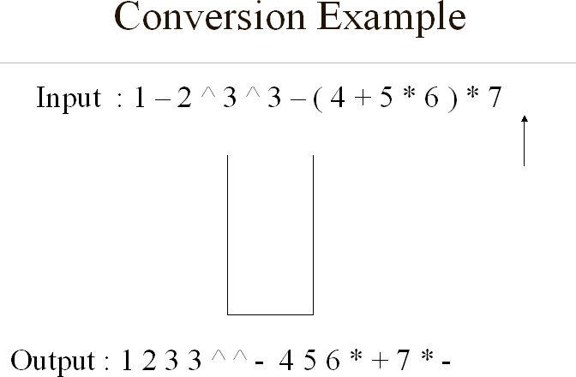
Cont…

Slide 21
Cont…
5. Computing Postfix Notation
AB+
+
B A
Op=pop()
Op1=pop() Op2=pop()
Result
Op2 op op1 = result Push (result)

Slide 22
Cont…
Example
AB+C*
+ B A
Result1
* C
Result1
Result2
+ 5
4
* 2
9
18
Eg. 4 5 +2*

Slide 23
Queue
A queue is an ordered collection of items for which we can only add an item at the back or remove an item from the front.
It operates on FIFO – first in first out basis
It has two operations
» Enqueue – adding data at the end of the list
» Dequeue – deleting data at the head of the list
Eg. Enqueue(c)
Enqueue (B)
C | B| A
Enqueue(A)
Dequeue()
Enqueue(D)
Dequeue()
| B| A
| B| A| D
A|D

Slide 24
Operations on queue
enqueue(): Inserts an element at the end of the queue i.e. at the rear end.
dequeue(): This operation removes and returns an element that is at the front end of the queue.
front(): This operation returns the element at the front end without removing it.
rear(): This operation returns the element at the rear end without removing it.
isEmpty(): This operation indicates whether the queue is empty or not.
isFull(): This operation indicates whether the queue is full or not.
size(): This operation returns the size of the queue i.e. the total number of elements it contains.

Slide 25
Simple array implementation of enqueue and dequeue
Analysis – consider the following structure int num[max-size];
We need the following variables
int rear=-1, front=-1, queuesize=0;

Slide 26
To enqueue
Check if there is space
Queuesize<max-size or //rear< max-size?
Yes: queuesize==0?
» Yes: increment front
» No: Increment rear and queuesize,
Store the data in num[rear]
No: queue overflow

Slide 27
To dequeue
Check if there is data
Queuesize>0?
Yes:
»Call dequeue() the data in num[front]
» Increment front
» Decrement queuesize
No: queue underflow

Slide 28
Example
Enqueue(5) →5
Enqueue(7) →5,7
Enqueue(4) →5,7,4
Dequeue() →7,4
Enqueue(2) →7,4,2
F R
5 |7|4|2

Slide 29
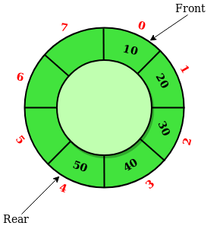
Circular queue
Rear of the queue is somewhere clockwise from the front.
To enqueue an element, we move rear one position clockwise and write the element in that position.
To dequeue, we simply move front one position clockwise.
Queue migrates in a clockwise direction as we enqueue and dequeue.
Emptiness and fullness to be checked carefully.

Slide 30
Array implementation of Circular Queue
Limitation of simple array implementation is, as we keep on dequeueing an element from the array, front may exceed maxsize, while we have some free spaces
E.g num[5]
dequeue(), dequeue(), dequeue(), dequeue(), dequeue(),
Enqueue(3) impossible
F R
5 | 7 | 6 | 11 | 8
R
F
| | |
|

Slide 31
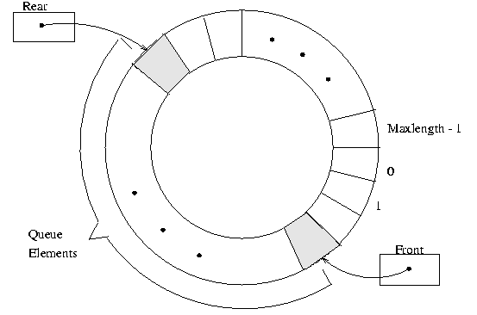
Array implementation of Circular Queue

Slide 32
To enqueue
Check if there is space
Quesize<max-size??
Yes:
» Queuesize==0??
Yes: increment front
Increment rear and queuesize
Rear==maxsize??
Yes: rear=0
Store the data in num[rear]
No: queue overflow

Slide 33
To dequeue
Check if there is data
Queuesize>0???
Yes:
» Copy the data in num[front]
» Increment front
» Front==max-size??
Yes:Front=0;
Decrement queuesize
No: queue underflow

Slide 34
Linked List Implementation of enqueue and dequeue
Enqueue – inserting node at the end of the list.
Dequeue – deleting the first node in the list.
Implementation – see the linked list adding at the end and deleting at the start example from the previous chapter

Slide 35
Different types of Queue
» Deque – is also double ended queue
– Insertion and deletion are possible at both ends
– Implementation are the same as that of queue
– Is best implemented by double linked list.

Slide 36
Priority queue
In priority queues, elements arrive in an arbitrary order, but are enqueued with information about their priority.
It is a queue where each element has an associated key value at the time of insertion.

Slide 37
Example
Original queue
Sara Solomon Ahmed F M M
Chaltu
F
Tola Saban M F
Female Queue
Sara Chaltu Saban
Male Queue
Solomon Ahmed Tola

Slide 38
Cont...
while (original queue is not empty)
{
data=dequeueOriginalQueue(); if(gender of data is male)
Enqueue maleQueue(data); else
Enqueue femaleQueue(data)
}

Slide 39
To create priority queue
While (female queue is not empty)
» Enqueue to priority queue (dequeue femaleQueue())
While (males queue is not empty)
» Enqueue to priority queue
Priority queue
Sara Chaltu
F F
Saban Solomon
F M
Ahmed Tola
M M

Slide 40
Example 2
The data with the largest element with higher priority
A | B | C | F | E | D | H
40 | 30 | 25 | 15 | 18 | 20 | 12
Dequeue() |  | A will |  | be selected
Dequeue() |  | B |  | >>
Dequeue() |  | C |  | >>
Dequeue() |  | D |  | >>

Slide 41
Application of Queue
1. printserver
print()
{
Enqueue printqueue(document)
}
End_of_print()
{
Dequeue printqueue()
}
Document1.doc letter.doc assign.cpp

Slide 42
Cont…
disk driver, the one first inserted will have first letter (eg. A:, B:, C:, D:, E…)
Task scheduler in multiprocessing system Eg. Printing 16, searching 5, browsing 17,
opening 7

Slide 43
Cont…
telephone calls in a busy environment
simulation of waiting line
» Line in a supermarket
» Line at cafeteria, bank and so on…

Slide 44
Chapter 5: tree data structure

Slide 45
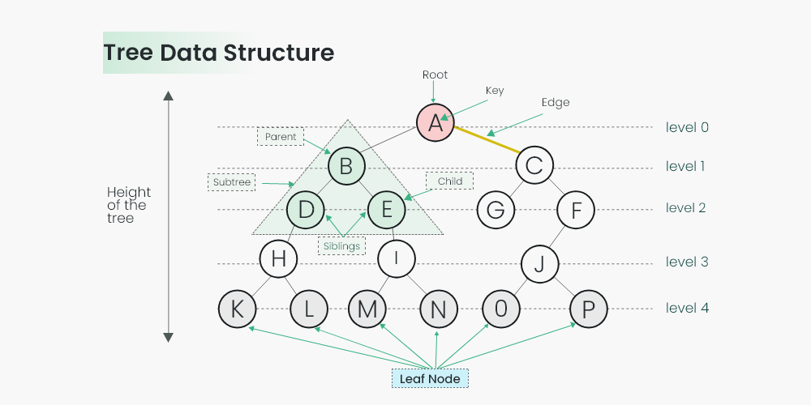
Cont…

